Slide 1
Guide to Networking Essentials,
6th Edition
Chapter 4: Network Media

Slide 2
Objectives
Define the primary cables used in wired networking
Describe the characteristics of the major types of fiber-optic media
Explain the technologies used for wireless networking
Copyright © 2012 Cengage Learning. All rights reserved.

Slide 3
Wired Networking
Wired networking uses tangible physical media called cables
Two broad categories of cables: copper wire and fiber optic
The main differences between the two types:
  Composition of signals (electricity or light)
  Speed at which signals can be sent
  Distance the signals can effectively travel
Copyright © 2012 Cengage Learning. All rights reserved.

Slide 4
Criteria for Choosing Network Media
Bandwidth Rating – number of bits per second that can be transmitted across a medium
  A factor determining bandwidth is how bit signals are represented on the medium (called encoding)
  When possible, choose a cabling category that’s compatible with the standard you want to implement now but will support the next level of speed your network is likely to need in the future
Maximum Segment Length – maximum length of cable between two network devices
  Each cable type can transport data only so far before its signals begin to weaken beyond what can be read by a receiving device (called attenuation)
Copyright © 2012 Cengage Learning. All rights reserved.

Slide 5
Criteria for Choosing Network Media
Interference and Eavesdropping Susceptibility
  Interference to electrical signals on copper media comes in the form of electromagnetic interference (EMI) and radio frequency interference (RFI)
  Motors, transformers, fluorescent lights, and other sources of intense electrical activity can emit both EMI and RFI
  RFI can also affect wireless networks if the frequencies are in the same range
  Another interference found in copper wires is called crosstalk, which is interference one wire generates on another wire when both wires are in a bundle
  Copper wire is susceptible to electronic eavesdropping
  Fiber-optic media carries light signals and is not susceptible to interference or eavesdropping
Copyright © 2012 Cengage Learning. All rights reserved.

Slide 6
Criteria for Choosing Network Media
Cable Grade
  Building and fire codes include specific cabling requirements
  Cables run between a false ceiling and the true ceiling (plenum) must be plenum-rated
  UTP Cabling is marked as communication cable riser (CMR) or communication cable plenum (CMP)
  CMR can only be used for building risers or in cable trays
  CMP is suitable for use in plenum spaces
Connection Hardware
  Every type of cable has connectors that influence the kinds of hardware the cable can connect to
  You must make sure the media you select can be supported by the network device
Copyright © 2012 Cengage Learning. All rights reserved.

Slide 7
Criteria for Choosing Network Media
Ease of installation – the difficulty of installing the media
  Factors to consider:
    media’s minimum bend radius, which limits the angle at which a cable can be bent to run around corners
    Cost and time needed to terminate the medium
    Physical environment – types of walls and ceilings, EMI or RFI
Testability – A network that “works” might be crippled by excessive errors
  It is important to certify whether the cable meets requirements for its category
Total cost – includes cabling, connectors, termination panels, wall jacks, termination tools, testing equipment and time
Copyright © 2012 Cengage Learning. All rights reserved.

Slide 8
Coaxial Cable
Often called “coax” for short
Once was the predominant form of network cabling
Inexpensive and easy to install
Started to phase out in the early 1990s
Still used primarily in connecting a cable modem to the wall outlet your cable TV/Internet provider installs
Copyright © 2012 Cengage Learning. All rights reserved.

Slide 9
Twisted-Pair Cable
Comes in two types: unshielded and shielded
Consists of one or more pairs of insulated strands of copper wires twisted around one another and housed in an outer jacket
Twists are necessary to improve resistance to crosstalk between the individual wires and EMI from outside sources
  The more twists per unit length, the better resistance to EMI and crosstalk
  More expensive TP is twisted more than less expensive and provides a better pathway for higher bandwidth networks
Copyright © 2012 Cengage Learning. All rights reserved.

Slide 10
Unshielded Twisted-Pair Cable
Most networks use Unshielded Twisted-Pair (UTP)
Consists of four pairs of insulated wires
Rated according to categories devised by the Telecommunications Industry Association (TIA) and Electronic Industries Alliance (EIA) and American National Standards Institutes (ANSI)
Categories 1 – 6e are accepted in U.S.
Two additional categories aren’t yet TIA/EIA standards and might never be in U.S.
  Europe has accepted Category 7 and 7a, which specify that each wire pair is shielded
Copyright © 2012 Cengage Learning. All rights reserved.

Slide 11
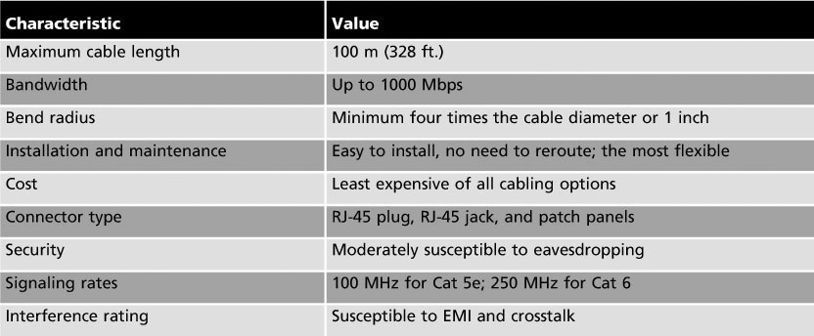
Unshielded Twisted-Pair Cabling
Categories 5e and 6 UTP Cabling Characteristics
  These categories are the most popular types of UTP cabling in today’s networks
Copyright © 2012 Cengage Learning. All rights reserved.

Slide 12
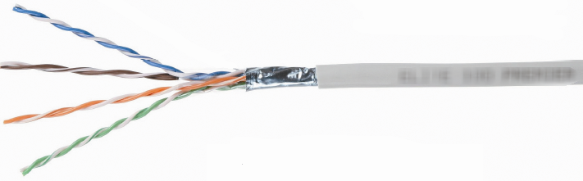
Shielded Twisted-Pair Cable
Includes shielding to reduce crosstalk and interference
  Has a wire braid inside the sheath material or a foil wrap
  Best to use in electrically noisy environments or very high-bandwidth applications
Copyright © 2012 Cengage Learning. All rights reserved.

Slide 13
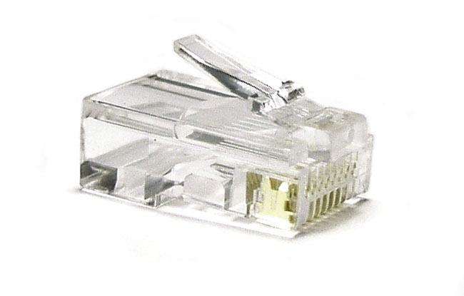
Twisted-Pair Cable Plant Components
RJ-45 Connectors – STP and UTP uses registered jack 45 (RJ-45)
  Most commonly used in patch cables, which are used to connect computers to hubs, switches, and RJ-45 wall jacks
Copyright © 2012 Cengage Learning. All rights reserved.

Slide 14
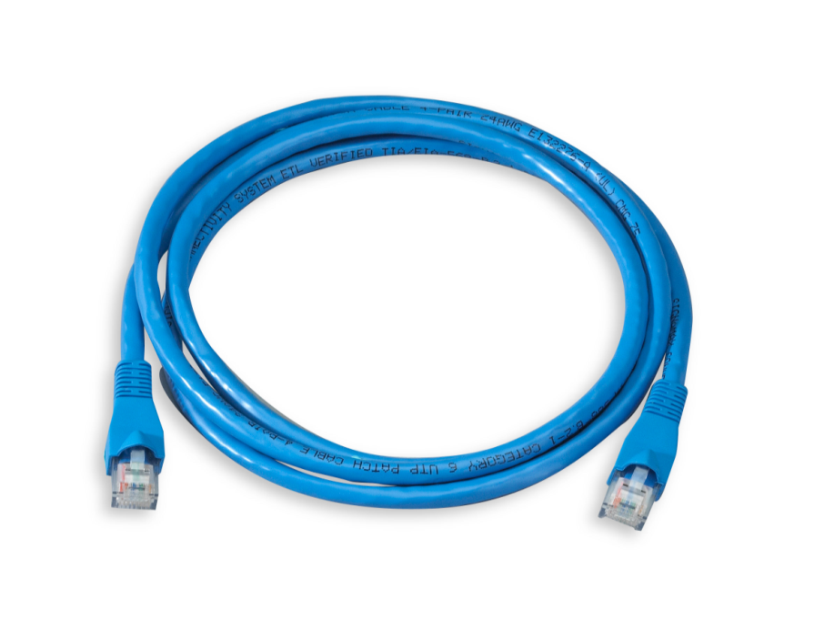
Twisted-Pair Cable Plant Components
Patch cable – short cable for connecting a computer to an RJ-45 wall jack or connecting a patch-panel port to a switch or hub
  Can be made with inexpensive tools, two RJ-45 plugs and a length of TP cable
Copyright © 2012 Cengage Learning. All rights reserved.

Slide 15
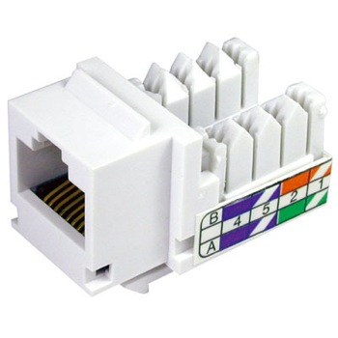
Twisted-Pair Cable Plant Components
RJ-45 jacks – what you plug an RJ-45 connector into when the computer is not near a switch or hub
  Usually placed behind wall plates when cables are run inside walls
Copyright © 2012 Cengage Learning. All rights reserved.

Slide 16
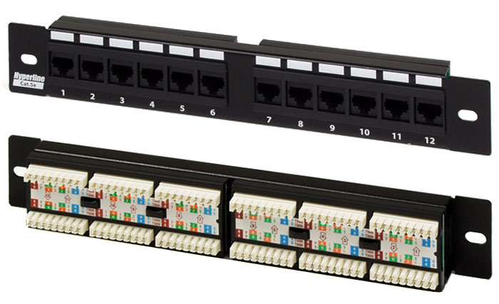
Twisted-Pair Cable Plant Components
Patch Panels – used to terminate long runs of cable from where the computers are to the wiring closet (where the switches and hubs are)
Copyright © 2012 Cengage Learning. All rights reserved.

Slide 17
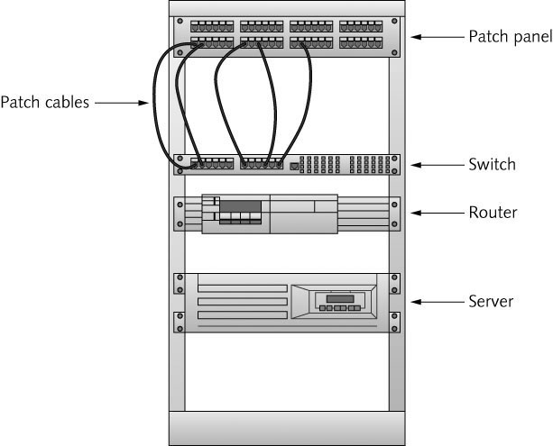
Twisted-Pair Cable Plant Components
Distribution racks – hold network equipment such as routers and switches, plus patch panels and rack-mounted servers
  (Also called 19” racks because the upright rails are 19” apart)
Copyright © 2012 Cengage Learning. All rights reserved.

Slide 18
Structured Cabling: Managing and Installing a UTP Cable Plant
Structured cabling specifies how cabling should be organized, regardless of the media type or network architecture
Large networks typically use most or all of these components:
  Work area
  Horizontal wiring
  Telecommunication closets
  Equipment rooms
  Backbone or vertical wiring
  Entrance facilities
Copyright © 2012 Cengage Learning. All rights reserved.

Slide 19
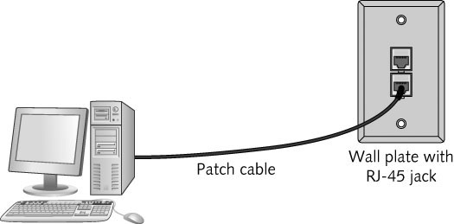
Structured Cabling: Managing and Installing a UTP Cable Plant
Work Area – where workstations and other user devices are located
  Faceplates and wall jacks are installed in the work area
  Patch cables connect computers and printers to wall jacks
Copyright © 2012 Cengage Learning. All rights reserved.

Slide 20
Structured Cabling: Managing and Installing a UTP Cable Plant
Horizontal wiring – runs from the work area’s wall jack to the telecommunication closet and is usually terminated at a patch panel
  Horizontal wiring from the wall jack to the patch panel should be no longer than 90 meters to allow for up to 10 meters for patch cables
Telecommunications Closet
  TC provides connectivity to computer equipment in the nearby work area
  Typical equipment includes patch panels to terminate horizontal wiring runs, hubs, and switches
  In smaller installations, network servers can be housed in the TC
Copyright © 2012 Cengage Learning. All rights reserved.

Slide 21
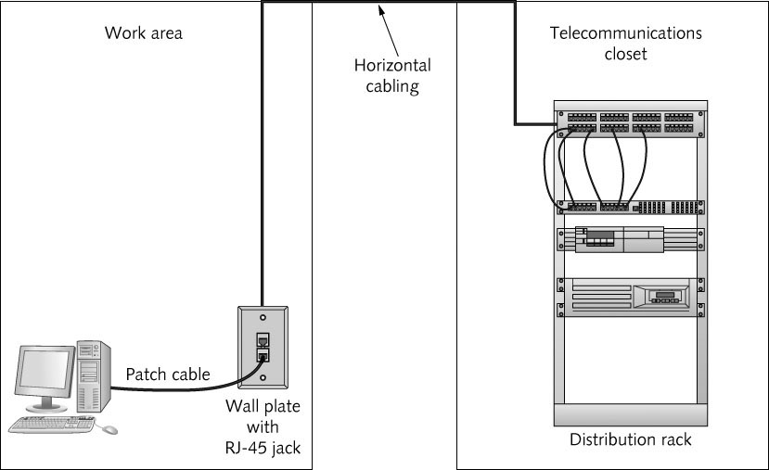
Structured Cabling: Managing and Installing a UTP Cable Plant
Work area, horizontal wiring, and telecommunications closet
Copyright © 2012 Cengage Learning. All rights reserved.

Slide 22
Structured Cabling: Managing and Installing a UTP Cable Plant
Equipment Room – house servers, routers, switches, and other major network equipment and serve as a connection point for backbone cabling
  Can be the main cross-connect for the entire network or it might serve as the connecting point for backbone cabling between buildings
Backbone Cabling – interconnects TCs and equipment rooms
  Runs between floors or wings of a building and between buildings
  Frequently fiber-optic cable, but can also be UTP if the distance between TCs is less than 90 meters
Copyright © 2012 Cengage Learning. All rights reserved.

Slide 23
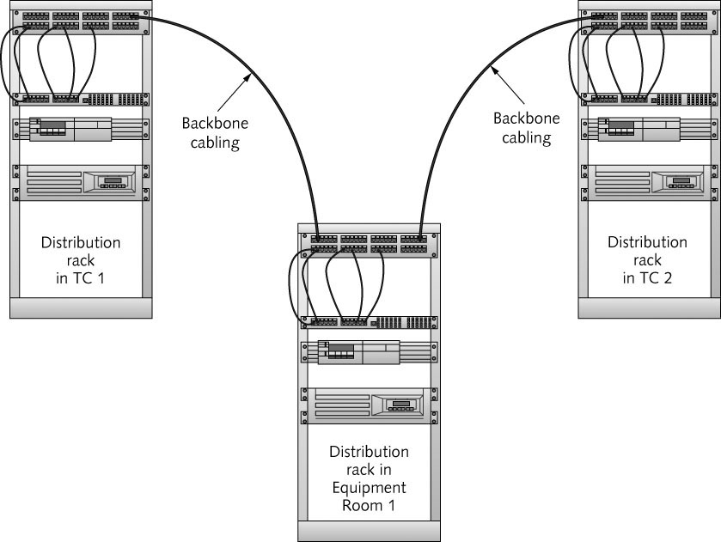
Structured Cabling: Managing and Installing a UTP Cable Plant
Backbone Cabling
Copyright © 2012 Cengage Learning. All rights reserved.

Slide 24
Structured Cabling: Managing and Installing a UTP Cable Plant
Entrance Facility – the location of the cabling and equipment that connects a corporate network to a third-party telecommunications provider
  Can also serve as an equipment room and the main
  cross-connect for all backbone cabling
  Where a connection to a WAN is made
  Demarcation point: point where corporate LAN equipment ends and a third-party provider’s equipment and cabling begins
Copyright © 2012 Cengage Learning. All rights reserved.

Slide 25
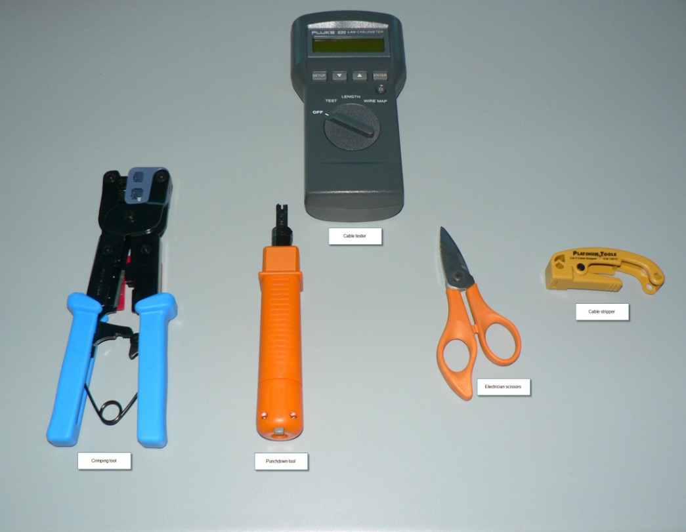
Installing UTP Cabling
Cable termination – putting RJ-45 plugs on the ends of cable or punching down wires into terminal blocks on a jack or patch panel
Some tools
needed:
- Wire cutters
- Crimping Tool
- Cable Tester
- Punchdown Tool
- Cable Stripper
- RJ-45 plugs/jacks
Copyright © 2012 Cengage Learning. All rights reserved.

Slide 26
Straight-Through Versus Crossover Cable
When making or terminating a cable you must get the colored wires arranged in the correct order
  Two standards of arrangement of wires: 568A and 568B
Standard patch cables are called straight-through cables (same wiring standard on both ends)
Crossover cables – use 568A standard on one side of the cable and 568B standard on the other side
  This type of cable is often needed when you connect two devices of the same type to one another
    Example: hub to hub, switch to switch, or PC to PC
Copyright © 2012 Cengage Learning. All rights reserved.

Slide 27
Medium Dependent Interface
Network devices that connect by using RJ-45 plugs over twisted-pair cabling are classified as medium dependent interface (MDI) devices or MDI crossed (MDI-X) devices
MDI devices transmit on pins 1 and 2 and receive on pins 3 and 6
  PC NICs and routers are examples
MDI-X devices receive on pins 1 and 2 and transmit on pins 3 and 6
  Hubs and switches are examples
When two switches (or any other like devices) need to be connected, you use a crossover cable so that transmit and receive wires get crossed
Copyright © 2012 Cengage Learning. All rights reserved.

Slide 28
Why Two Transmit and Two Receive Wires?
One wire pair is used for transmit (labeled transmit+/transmit-) and one pair for receive (labeled receive+/receive-)
The plus and minus symbols indicate that the wires carry a positive and negative signal
  This differential signal mitigates the effect of crosstalk and noise on the cable
Copyright © 2012 Cengage Learning. All rights reserved.

Slide 29
Fiber-Optic Cable
Bits are transmitted as pulses of light instead of electricity
Immune to electrical interference
Highly secure – electronic eavesdropping is eliminated
Composition
  A slender cylinder of glass fiber called the core is surrounded by a concentric layer of glass called the cladding
  Fiber is then jacketed in a thin transparent plastic material called the buffer
Copyright © 2012 Cengage Learning. All rights reserved.

Slide 30
Fiber-Optic Cable
Each fiber-optic strand carries data in only one direction
  Network connections consist of two or more strands
Like UTP patch cables, fiber-optic patch cables usually connect from a fiber-optic patch panel to a switch or router
Fiber-optic cable used as backbone cabling often comes in bundles of 12 or more fiber strands
  Even only using 2 in the backbone, running more is a good idea so that you are ready for any future expansion
Some testing has shown that glass fibers can carry several terabits per second
  It is speculated that fiber-optic cable will probably one day replace copper for all types of network connections
Copyright © 2012 Cengage Learning. All rights reserved.

Slide 31
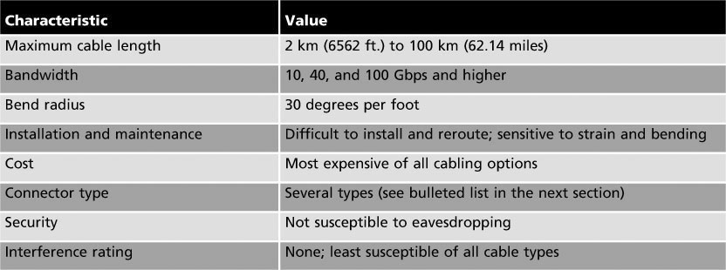
Fiber-Optic Cable
Fiber-optic cable characteristics
Copyright © 2012 Cengage Learning. All rights reserved.

Slide 32
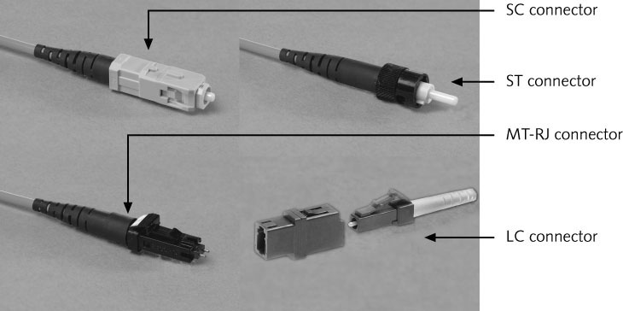
Fiber-Optic Connectors
Copyright © 2012 Cengage Learning. All rights reserved.

Slide 33
Fiber-Optic Installation
Somewhat more difficult and time consuming than copper media installation
Connectors and test equipment required for termination are still more expensive than copper
There are many methods for terminating fiber-optic cables because of the many connectors and cable types available
  Installation details are beyond the scope of this book
Copyright © 2012 Cengage Learning. All rights reserved.

Slide 34
Fiber-Optic Cable Types
Single-mode fiber (SMF)
  Includes a single, small-diameter fiber at the core (8 microns)
  Costs more and generally works with laser-based emitters
  Spans the longest distances
  Used in higher-bandwidth applications
Multimode fiber (MMF)
  Uses a considerably larger diameter fiber at the core (50 and 62.5 microns)
  Costs less than SMF
  Works with lower-power light emitting diodes (LEDs)
  Spans shorter distances
Copyright © 2012 Cengage Learning. All rights reserved.

Slide 35
Wireless Networking
As wireless networking has become more affordable, demand has increased
Many home users have turned to wireless networks
Wireless networks are often used with wired networks to interconnect geographically dispersed LANs or groups of mobile users with wired servers and resources on a wired LAN (sometimes referred to as “hybrid networks”)
Even in small networks with workstations connecting to a wireless AP or router, the AP or router usually connects to the Internet via a wired connection to a cable modem
Copyright © 2012 Cengage Learning. All rights reserved.

Slide 36
Wireless Benefits
Creates temporary connections to existing wired networks.
Establishes backup or contingency connectivity for existing wired networks
Extends a network’s span beyond the reach of wire-based or fiber-optic cabling, especially in older buildings where rewiring might be too expensive
Allows businesses to provide customers with wireless networking easily, offering a service that gets customers in and keeps them there
Enables users to roam around a corporate or college campus with their machines
Copyright © 2012 Cengage Learning. All rights reserved.

Slide 37
Types of Wireless Networks
Local area networks (LANs) – usually provide connectivity for mobile users or across areas that couldn’t otherwise be networked
Extended LANs – usually used to increase a LAN’s span beyond normal distance limitations
Internet service – used to bring Internet access to homes and businesses
Mobile computing – users communicate by using a wireless networking medium that enable them to move while remaining connected to a network
Copyright © 2012 Cengage Learning. All rights reserved.

Slide 38
Wireless LAN Components
Network interface attaches to an antenna and an emitter rather than to a cable
Transceiver/access point – a transmitter/receiver device that must be installed to translate between wired and wireless networks
  Includes an antenna and a transmitter to send and receive wireless traffic but also connects to the wired side of the network
  Shuttles traffic back and forth between a network’s wired and wireless sides
Copyright © 2012 Cengage Learning. All rights reserved.

Slide 39
Wireless LAN Transmission
Signals take the form of waves in the electromagnetic (EM) spectrum
The frequency of the wave forms used for communication is measured in cycles per second, usually expressed as hertz (Hz)
The principles governing wireless transmissions dictate that lower-frequency transmissions can carry less data more slowly over longer distances, and higher-frequency transmissions can carry more data faster over shorter distances
Copyright © 2012 Cengage Learning. All rights reserved.

Slide 40
Wireless LAN Transmission
The following are the most commonly used frequencies for wireless data communication:
  Radio – 10 KHz to 1 GHz
  Microwave – 1 GHz to 500 GHz
  Infrared – 500 GHz to 1 THz (terahertz)
Wireless LANs make use of four primary technologies for transmitting and receiving data
  Infrared
  Laser
  Narrowband (single-frequency) radio
  Spread-spectrum radio
Copyright © 2012 Cengage Learning. All rights reserved.

Slide 41
Infrared LAN Technologies
Infrared (IR) wireless networks use infrared light beams to send signals between pairs of devices
  Work well for LAN applications because of their high bandwidth
  Four main kinds of infrared LANs
    Line-of-sight networks – require an unobstructed view between transmitter and receiver
    Reflective wireless networks – broadcast signals from optical transceivers near devices to a central hub
    Scatter infrared networks – bounce transmissions off walls and ceilings to deliver signals
    Broadband optical telepoint networks – provide broadband services
Copyright © 2012 Cengage Learning. All rights reserved.

Slide 42
Laser-Based LAN Technologies
Also require a clear line of sight between sender and receiver
Aren’t as susceptible to interference from visible light sources as infrared
Copyright © 2012 Cengage Learning. All rights reserved.

Slide 43
Narrowband Radio LAN Technologies
Use low-powered, two-way radio communication
Receiver and transmitter must be tuned to the same frequency to handle incoming and outgoing data
Requires no line of sight between sender and receiver as long as both parties stay within the broadcast range of these devices (typically 70 meters or 230 feet)
Depending on the frequency, walls or other solid barriers can block signals
Interference from other radio sources is also possible
Copyright © 2012 Cengage Learning. All rights reserved.

Slide 44
Spread-Spectrum LAN Technologies
Uses multiple frequencies simultaneously, improving reliability and reducing susceptibility to interference
  Also makes eavesdropping more difficult
Two main kinds of spread-spectrum communications
  Frequency hopping: switches data between multiple frequencies at regular intervals
  Direct-sequence modulation: breaks data into fixed-size segments called chips and transmits the data on several different frequencies at the same time
Copyright © 2012 Cengage Learning. All rights reserved.

Slide 45
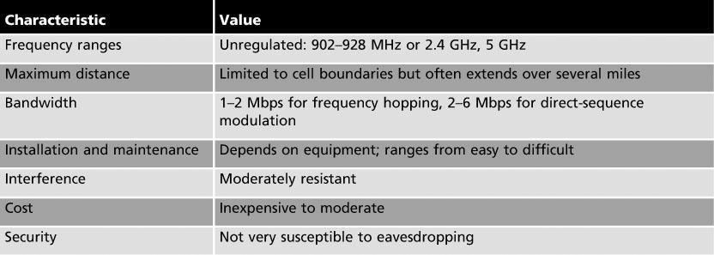
Wireless Extended LAN Technologies
Wireless bridges – can connect networks up to three miles apart
  Permit linking locations by using line-of-sight or broadcast transmissions
  Eliminate the need for a third-party communications carrier
  Longer-range wireless bridges are also available (up to 25 miles)
Copyright © 2012 Cengage Learning. All rights reserved.

Slide 46
Microwave Networking Technologies
Microwave systems deliver higher transmission rates than radio-based systems
  Transmitters and receivers must share a common clear line of sight
Terrestrial microwave systems use tight-beam, high frequency signals to link sender and receiver
  By using relay towers, microwave systems can extend a signal across continental-scale distances
  Many communications carriers use microwave towers to send traffic across sparsely populated areas
Satellite microwave systems send and receive data from geosynchronous satellites that maintain fixed positions in the sky
  Most organizations must lease frequencies from global communications carriers
Copyright © 2012 Cengage Learning. All rights reserved.

Slide 47
LAN Media Selection Criteria
Three main media choices: UTP, fiber-optic, and wireless
When having difficulty choosing between media types consider:
  Bandwidth – Higher bandwidth means more expensive cable and higher installation costs
    If you need 40 Gbps or more, then fiber-optic is really your only choice
  Budget – A typical UTP cable installation cost $100 - $200 per cable run and fiber-optic might cost twice that much
    Wireless have no physical installation costs but you need to install access points and verify connectivity
Copyright © 2012 Cengage Learning. All rights reserved.

Slide 48
LAN Media Selection Criteria
Environmental considerations – How electrically noisy is the environment? How important is data security?
  The more weight either factor has, the more likely fiber-optic or secured wireless is the right choice
Span – What kind of distance must the network span?
  Longer spans might require fiber-optic or wireless be used between buildings
  Strategic placement of small switches or hubs gives UTP surprising reach
Existing cable plant – For an upgrade, the existing cable plant must be considered
  If some existing cable is to remain, is it compatible with the speeds and new equipment that are planned?
Copyright © 2012 Cengage Learning. All rights reserved.

Slide 49
Chapter Summary
Wired networking media come in two primary categories: copper and fiber-optic
Twisted-pair cabling comes in shielded or unshielded varieties
Twisted-pair cabling components consist of connectors, patch cable, jacks, patch panels, and distribution racks
A structured cabling plant consists of work areas, horizontal wiring, telecommunications closets, equipment rooms, backbone cabling, and entrance facilities
Copyright © 2012 Cengage Learning. All rights reserved.

Slide 50
Chapter Summary
Fiber-optic uses pulses of light to represent bits and is immune to EMI, RFI, and electronic eavesdropping
Wireless networks can be subdivided into LANs, extended LANs, and mobile computing
Components of a wireless LAN are a NIC, an antenna, and a transceiver or access point
Different technologies are used to transmit and receive data including: infrared, laser, narrowband radio, and spread-spectrum radio
Networks combining fiber-optic, UTP, and wireless have become the norm
Copyright © 2012 Cengage Learning. All rights reserved.

